Slide 1
Assessment of Amazon Comprehend Medical: Medication Information Extraction
Benedict Guzman, MS, Isabel Metzger, MS, Yindalon Aphinyanaphongs, M.D., Ph.D.,
Himanshu Grover, Ph.D.
NYU Langone Health, New York, NY
Gabriel H. Lins
Mestrando ISD

Slide 2
What Is Amazon Comprehend?
Amazon Comprehend uses natural language processing (NLP) to extract insights about the content of documents and processes any text file in UTF-8 format, and semi-structured documents, like PDF and Word documents. It develops insights by recognizing the entities, key phrases, language, sentiments, and other common elements in a document.
Some of the insights that Amazon Comprehend develops about a document include:
Entities – Amazon Comprehend returns a list of entities, such as people, places, and locations, identified in a document.
Key phrases – Amazon Comprehend extracts key phrases that appear in a document. For example, a document about a basketball game might return the names of the teams, the name of the venue, and the final score.
PII – Amazon Comprehend analyzes documents to detect personal data that could be used to identify an individual, such as an address, bank account number, or phone number.
Language – Amazon Comprehend identifies the dominant language in a document. Amazon Comprehend can identify 100 languages.
Sentiment – Amazon Comprehend determines the emotional sentiment of a document. Sentiment can be positive, neutral, negative, or mixed.
Syntax – Amazon Comprehend parses each word in your document and determines the part of speech for the word. For example, in the sentence "It is raining today in Seattle," "it" is identified as a pronoun, "raining" is identified as a verb, and "Seattle" is identified as a proper noun.

Slide 3
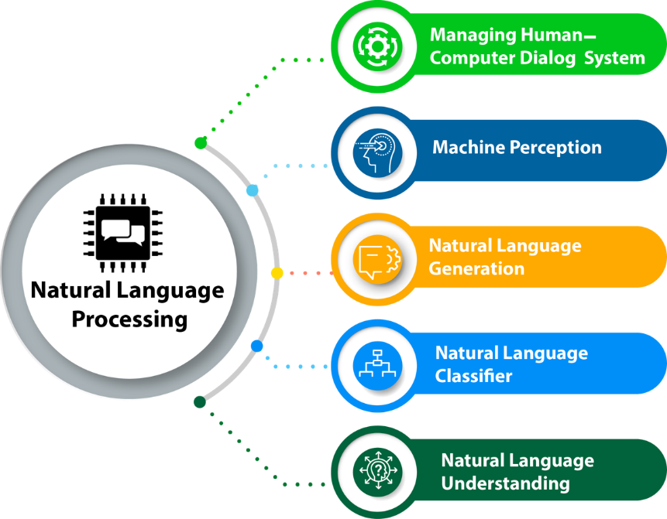
natural language processing (NLP)
The process of computer analysis of input provided in a human language (natural language), and conversion of this input into a useful form of representation.
The field of NLP is primarily concerned with getting computers to perform useful and interesting tasks with human languages.
The field of NLP is secondarily concerned with helping us come to a better understanding of human language.

Slide 4
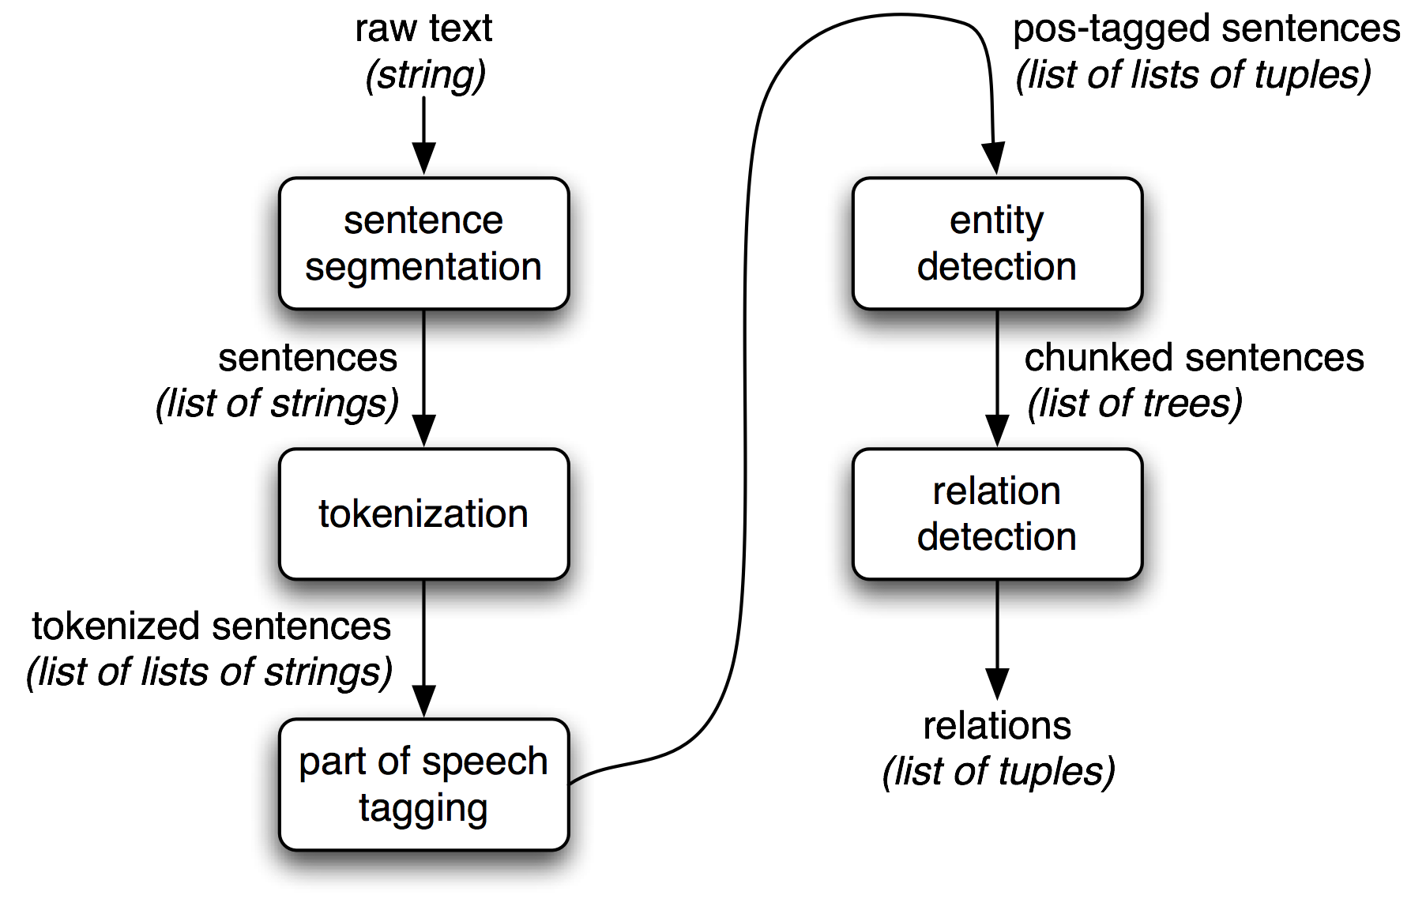
information extraction (IE)

Slide 5
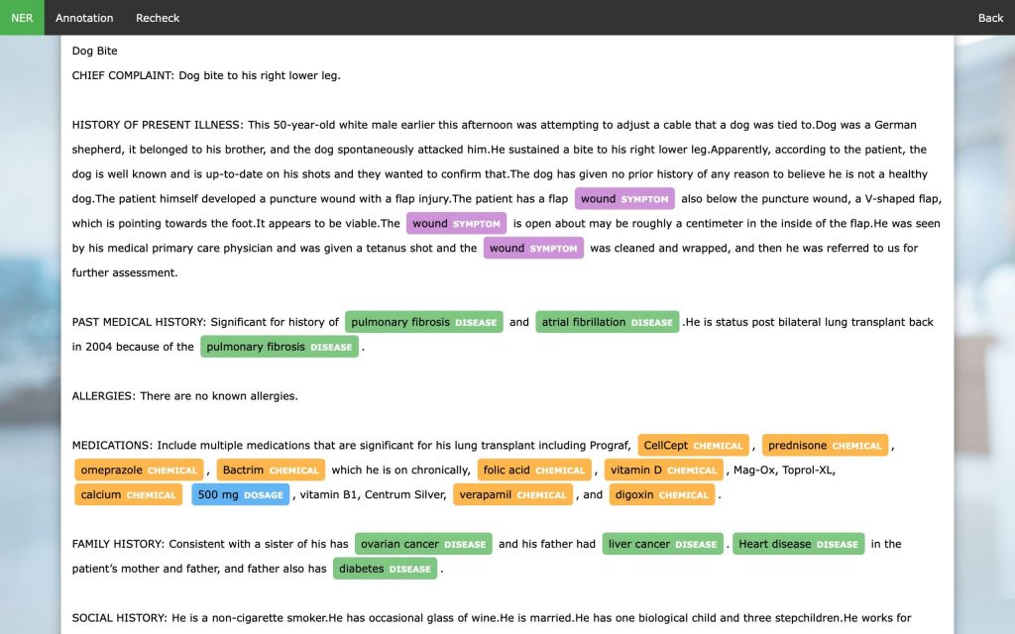
named entity recognition (NER)
Which deals with recognition of entities and classification into predefined categories such as person names, places, or organizations, and relationship extraction (RE), which focuses on identification of the relationships amongst extracted entities.

Slide 6
Amazon Comprehend Medical
A deep learning based system that automatically extracts clinical concepts like:
1. Anatomy: relates to the body parts and systems and the corresponding location/directionality (e.g. dorsal, ventral, proximal, and distal).
2. Medical Condition: involves the diagnosis name and the corresponding acuity (e.g. chronic or acute), signs and symptoms.
3. Protected Health Information: focuses on various PHI such as patient’s name, birthdate, and social security number.
4. Test Name, Treatment Name, and Procedure Name: deals with diagnostic testing, interventions, and treatment procedures that relate to a medical condition.
5. Medications: includes the name (i.e. generic name and brand name), dosage, duration, frequency, form, frequency, mode, rate, and strength.

Slide 7
Amazon Comprehend Medical
ACM’s is backed by deep learning algorithms.
To perform NER, it utilizes a neural network architecture which constitutes two Long Short-Term Memory (LSTM) encoders at the character and word level, and a single LSTM tag decoder.
This base framework is further modified by the addition of transfer learning via Tunable Transfer network (TTN) and Dynamic Transfer Networks (DTN), which exploit parameter sharing schemes and gating.
Such configuration overcomes the major limitation of limited access to medical data for training purposes and ensures generalizability of the system across different medical specialties.
Outputs from the NER decoder are fed to an entity softmax layer, which then are used as input for the negation softmax layer to detect negation of concepts. Finally, ACM’s RE function features a method that combines second-order relation scores—which utilizes a context token that connects the two target entities—and first-order relation scores.

Slide 8
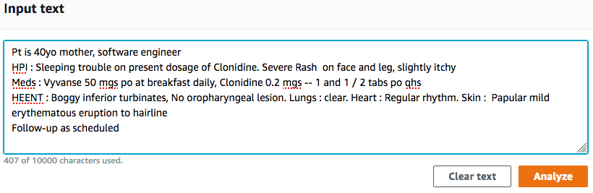
How does it works?
AWS Console

Slide 9
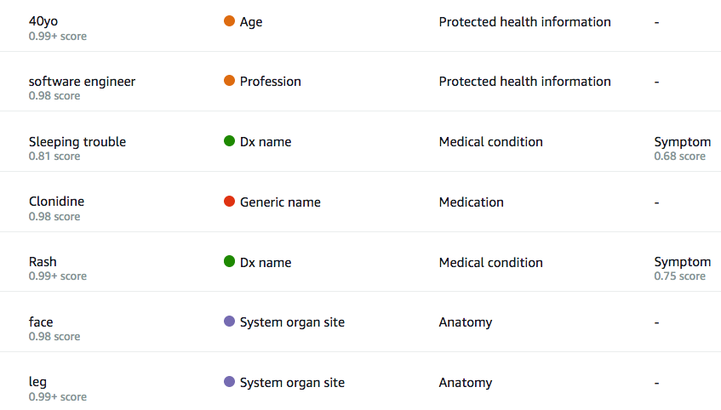
How does it works?
AWS Console

Slide 10
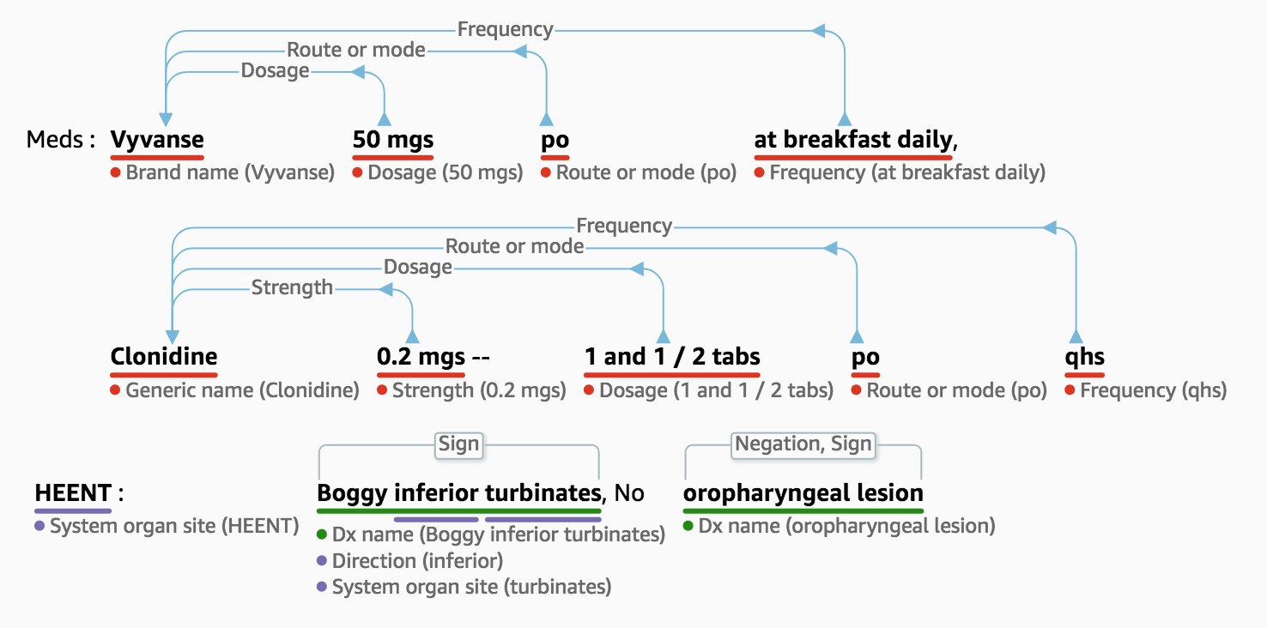
How does it works?
AWS Console

Slide 11
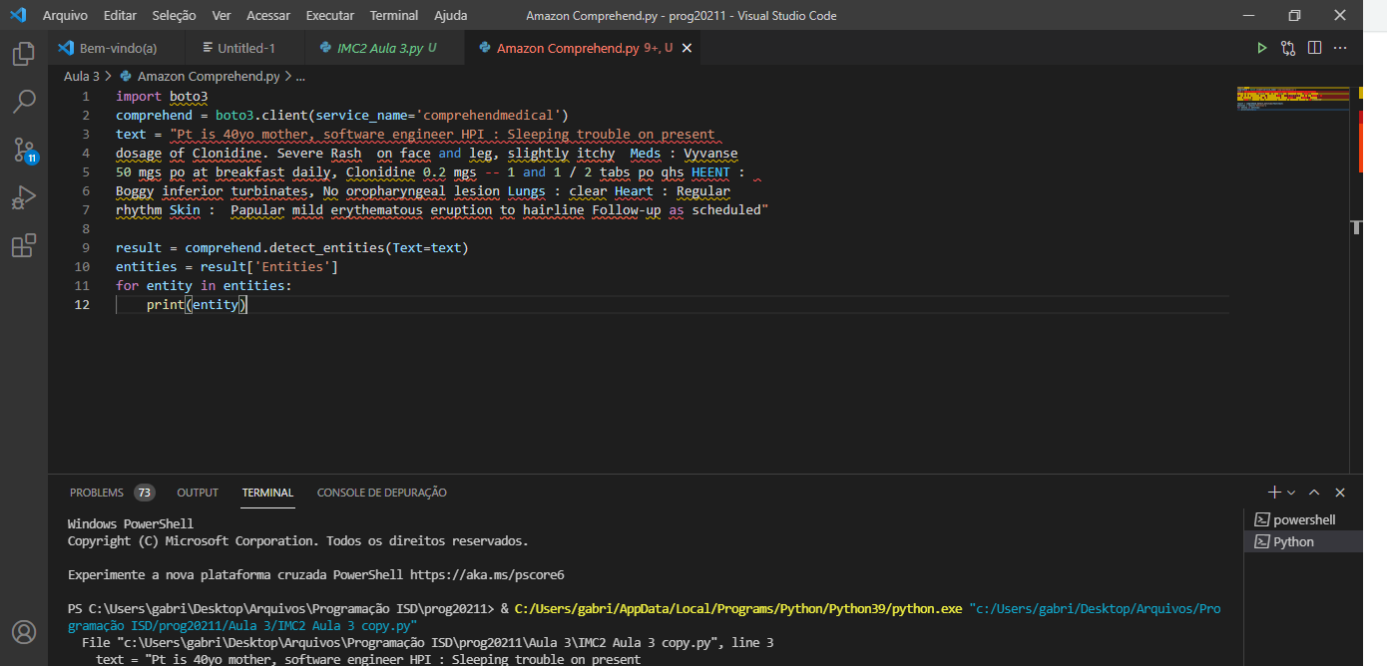
Testing on pyhthon (vscode)
AWS SDK for Python

Slide 12
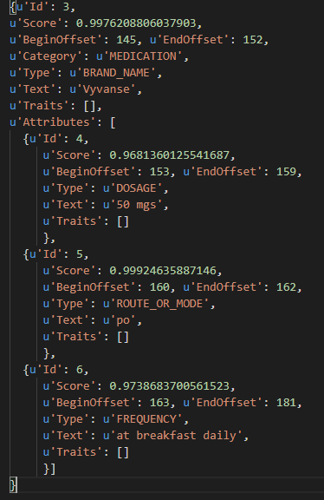
Results

Slide 13
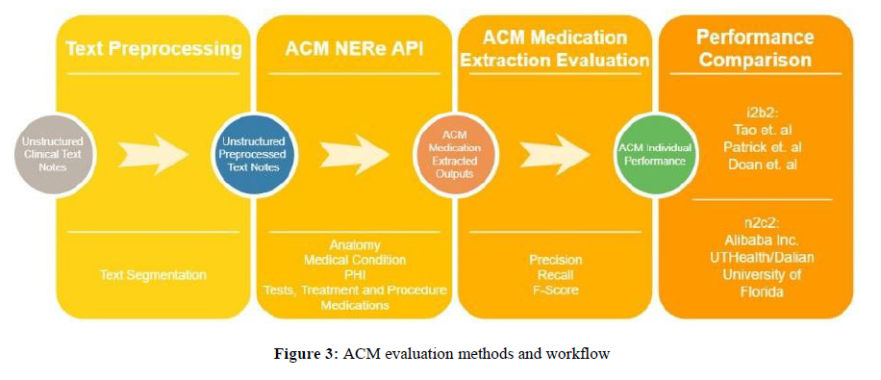
PAPER Method

Slide 14
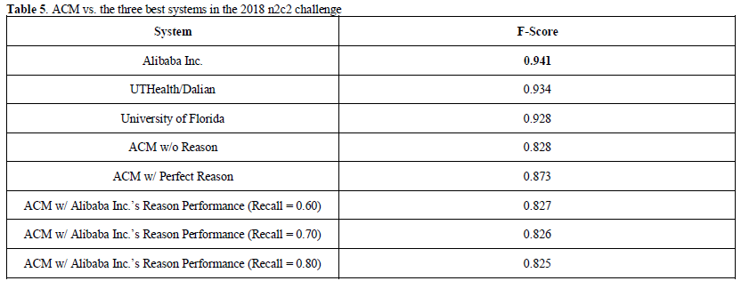
PAPER RESULTS

Slide 15
Paper Discussion and conclusion
Analysis showed that ACM achieved a precision=0.913, recall=0.488, and F-score=0.636 for its performance on the former and a precision=0.939, recall=0.208, and F-score=0.341 for the latter. Similarly, other systems that participated in the 2009 i2b2 challenge also scored better when extracting entities from lists than from narratives.
Based on all the evaluation datasets, one of the most noticeable deficiencies of ACM pertains to misclassification of certain medications as treatment names.
Altogether, ACM presents a promising approach with its built-in simplicity and usability. The combination of all the above factors can empower end-users to innovate and drive usage. In terms of its performance for medication information extraction, however, better systems do exist, at least for now.

Slide 16
Study limitations
First, ACM was only evaluated on the medication extraction task. This implies that its performance for the medication category may not necessarily reflect its performance for other clinical concepts, which include anatomy, medical condition, PHI, test name, treatment name, and procedure names.
This work was also not able to analyze negation of medication entities and the field pertaining to the rate of medication because all of the three evaluation datasets were not annotated for these information.
Therefore, future work should involve exploration of all these aspects. Lastly, the results presented in this work were all outputs form ACM’s first release version, which was publicly available on November 27, 2018. There may have been updates and changes to its existing machinery from the time leading to the completion of this work on June 2019.

